Slide 1
WHERE DOES THE OVERWEIGHTING OF LOW PROBABILITIES COME FROM? Marcin Penconek Quantitative Psychology and Economics (UW) Feb 2022

Slide 2
MY ANSWER
Δt = 30-40ms
3*d / Δt
d=14.2ms

Slide 3
INTRODUCTION
Risk-aversion is human decision-making is known for centuries. Evidence of risk aversion is present in decisions of other species (Caraco et al., 1990; Bateson, 2002).
Early explanation of risk aversion (for gains) is due to Daniel Bernoulli (1738) who suggested that people evaluate options by their utility rather than by their objective value. Utility is a concave function of the objective value (saturation of needs) which leads to risk-aversion.
Expected utility theory was formalized by von Neumann and Morgenstern (1947).
However, Allais paradox (1953) shows inconsistency of human choices with the expected utility theory (e.g., certainty effect).
Prospect Theory (Kahneman and Tversky, 1977, 1979) conceptualizes subjective value of a lottery as a product of value function v(x) and the probability weighting function w(p), i.e., V(x, p) = v(x)*w(p).

Slide 4
A
v(x)
x
u(x)
Input
B
w(x)
π(p)
p
Hypothesis: π(p) = p
(*) Glimcher (2022): ”Efficiently Irrational: Illuminating the Riddle of Human Choice”

Slide 5
NEUROPHYSIOLOGY OF RISK AND UNCERTAINTY
Experimental studies using willingness to pay paradigm (Plassmann et al., 2007; Chib et al., 2009) showed that ventromedial PFC encodes decision utility across a broad range of goods (a final common pathway for value representation). Ballesta et al. (2020) proved a casual role of values encoded in OFC to economic choices.
There is an evidence for neuronal signals representing probability, risk (variance and skew) and uncertainty at the level of single neurons and brain regions (reviews: Bach and Dolan, 2012; Burke and Tobler, 2011; Mohr et al. , 2010; Platt and Huettel, 2008; Rushworth and Behrens, 2008; Schultz et al., 2008, 2011).
Research on monkeys (Fiorillo et al., 2003; McCoy & Platt, 2005; O’Neill & Schultz, 2010; Platt & Glimcher, 1999) shows that risk is encoded in neuronal activity in brain regions involved in making decisions.
Correlations between nonlinearities of the Prelec probability weighting function and neuronal responses in brain regions (anterior cingulate cortex, dorsal striatum) between individuals has been found (Paulus and Frank, 2006; Hsu et al., 2009). Nonlinearity of weighting function was also associated with dopamine D₁ receptor density in the striatum, i.e., lower D₁ densities as measured with PET connected with a greater degree of nonlinearity (Takahashi et al., 2010). However, no casual link was established.

Slide 6
EXPECTED UTILITY VS. MEAN-VARIANCE*
TEST: CHANGE VALUES ONLY
CONTROL: CHANGE VALUES AND PROBABILITIES
Expected utility optimizers:
Will not resample if only values change - over 50% of subjects re-sampled
Length of sampling depends on the number of states (colours) – probability to re-sample increased with the number of states
Will never buy dominated games and pass on gambles dominated by price – very few cases
(*) D’Acremont and Bossaerts (2008): ”Neurobiological studies of risk assessment:
A comparison of expected utility and mean-variance approaches”

Slide 7
ENCODING PROBABILITY
CONDITIONS:
A
Input channel with m=20 neurons

Slide 8
TASK:
brain has 20 neurons, and
needs to calculate any integral in a way that uniquely identifies the probability distribution

Slide 9
MONTE CARLO
t
Δt
I_{k} ∝ u(X_{k})
X₁X₂ X_{n}
I₁
I₂
I_{n}
Law of Large Numbers
Glivenko-Cantelli Theorem

Slide 10
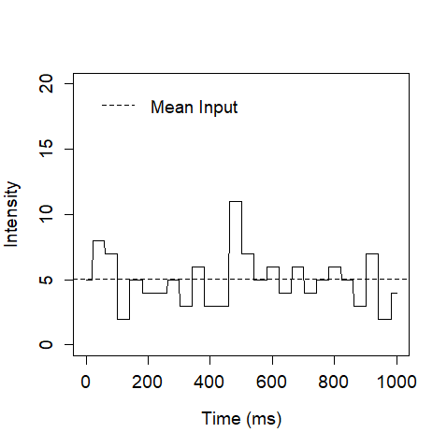
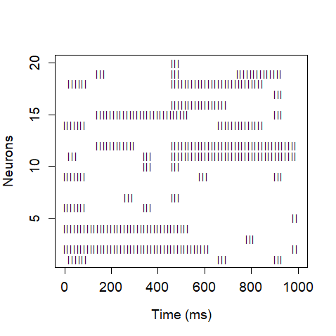
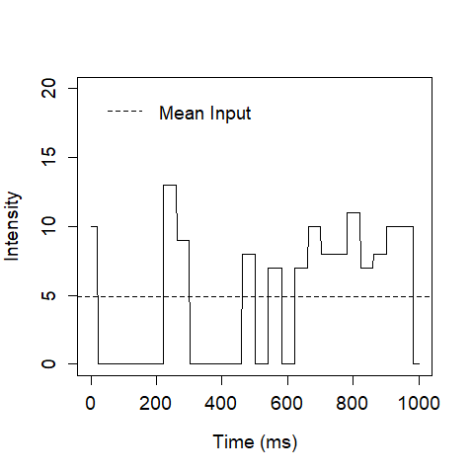
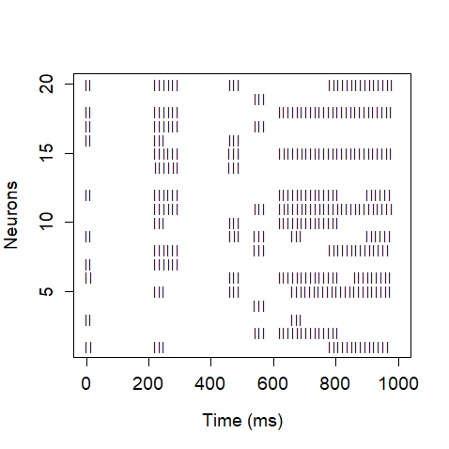
(5)
INTENSITY
NEURAL CODE
(10, 0.5)
Δt = ?

Slide 11
DECISION MAKING MODEL*
Excitatory neurons only
Non-linear global inhibition:
Up-dates based on the Poisson process (Wójcik, 2018)
Strong recurrent connections in decision sets A and B
Alternative models:
Drift Diffusion Model (Ratcliff, 1978)
Wang’s model (Wang, 2002, Wong and Wang, 2006)
A
B
(*) Penconek (2020): ”Decision making model based on attractor network with binary neurons”

Slide 12
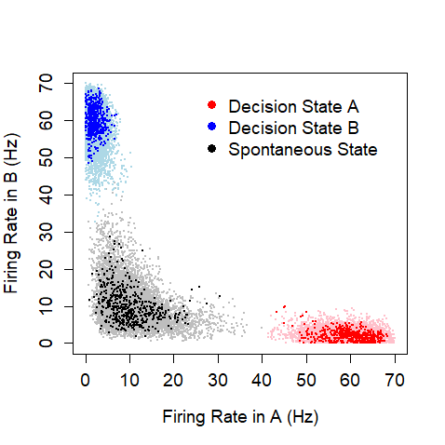
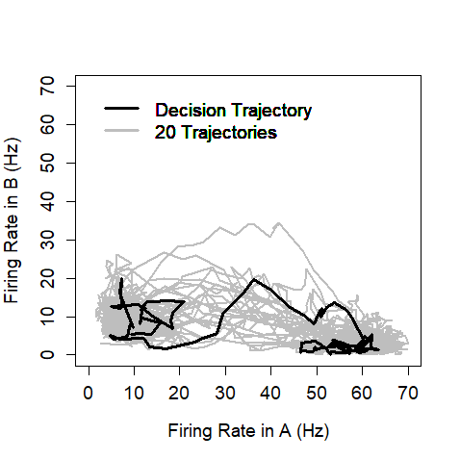
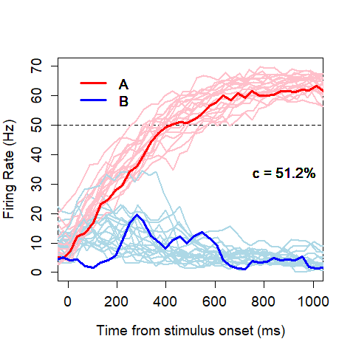
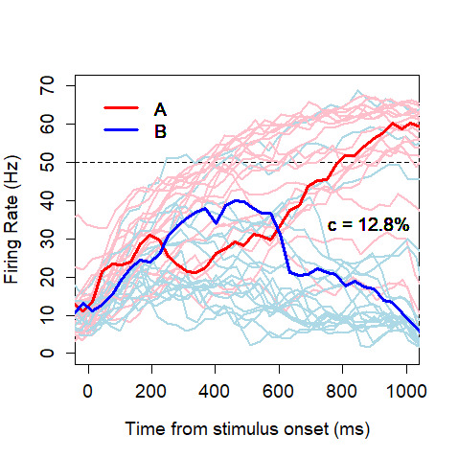
Three steady-states
Probabilistic decision-making
RT decreases with stronger stimulus
Error decisions take longer than correct ones

Slide 13
MODEL VALIDATION
Roitman and Shadlen (2002): ” Response of Neurons in the Lateral Intraparietal Area during a Combined Visual Discrimination Reaction Time Task”
Peixoto et al. (2021): ”Decoding and perturbing decision states in real time”
non-linear accumulation effects
Rafiei and Rahnev (2021): ”Qualitative speed-accuracy tradeoff effect that cannot be explained by the diffusion model under the selective influence assumption”
non-linear speed-accuracy tradeoff effects

Slide 14
ELICITATION OF THE WEIGHTING FUNCTION
Abdellaoui (2000) non-parametric method:
Standard sequence of outcomes (x₀, x₁… x_{n}) such that v(x_{i+1}) - v(x_{i}) = const
Establishing indifference: (x_{n}, p_{i}; x₀) ~ x_{i}
Note that this procedure is independent of our function u(x) assuming it is strictly increasing and contineous, i.e., the elicitation can be conducted in the ”utility space”. Why?
u₀, u₁… u_{n}
CHOICE
x₀, x₁… x_{n}
Choice is made based on u(x_{i}), i.e., on u_{i}
x_{i}=u⁻¹(u_{i})

Slide 15
SIMULATIONS & RESULTS

Slide 16
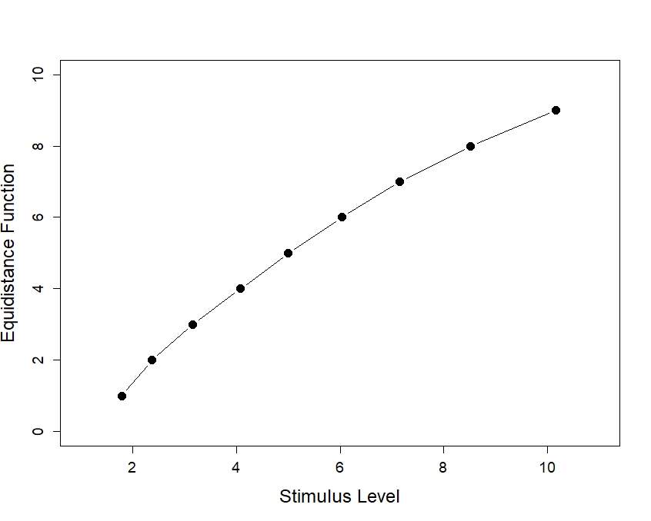
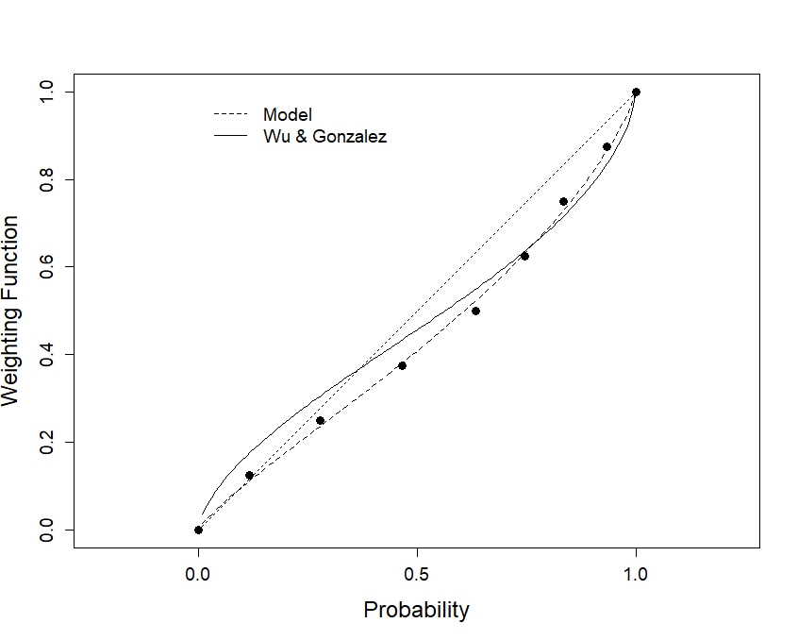
MY FIRST ATTEMPT
Standard sequence of outcomes (Weber Law*)
Weighting Function**
*Evidence with the Wang model: Deco et al. (2007): ”Weber’s Law in Decision Making: Integrating Behavioral Data in Humans with a Neurophysiological Model” Deco and Rolls (2006): ”Decision-making and Weber’s law: a neurophysiological model”
**Wu and Gonzalez (1999): ”On the Shape of the Probability Weighting Function”

Slide 17
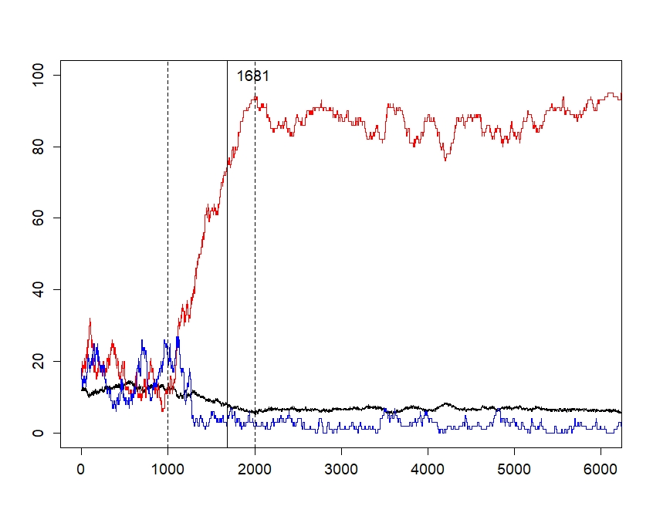
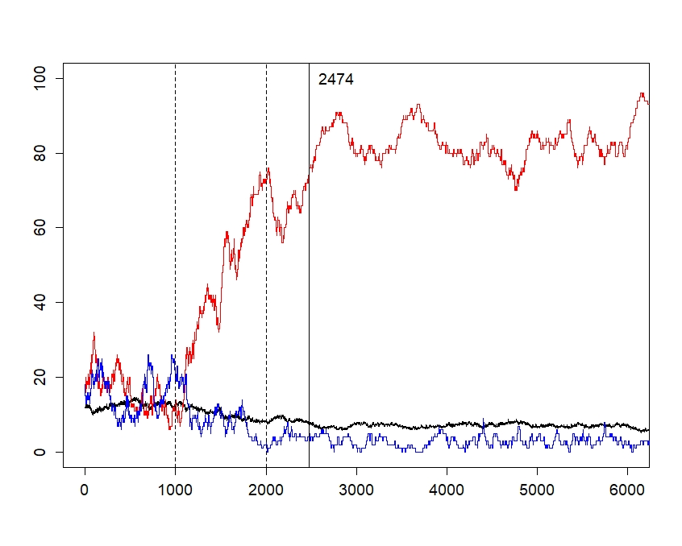
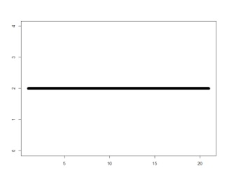
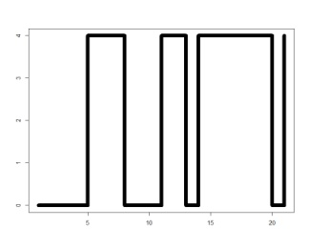
UNDERWEIGHTING: AN ILLUSTRATIVE EXAMPLE
A
B
STIMULUS
A: 2 neurons
B: no stimulus
STIMULUS
A: 4 neurons with prob 0.5 (sampling 50ms)
B: no stimulus

Slide 18
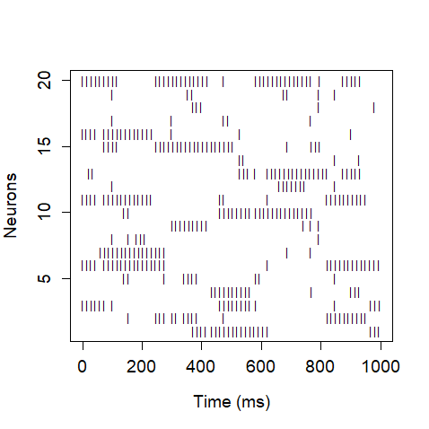
THREE LEVELS OF REALISM
1)
I = 3.14
Simulating the model with intensities represented as real numbers (i.e., without taking into account that the input channel consists of a limited number of neurons).
Simulating the model with ”normative” intensities, i.e., with the stepwise function in gamma frequency for representing utility levels and low beta frequency to represent probability.
Defining the neural code based on „normative” intensities and simulate the model with the neural code.
+ I
2)
3)

Slide 19
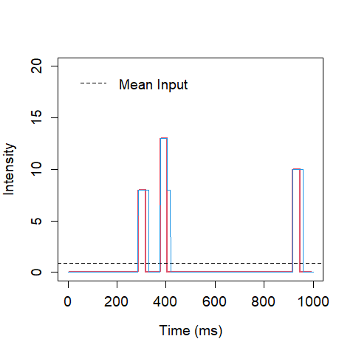
OVERWEIGHTING: MECHANISM
Δt = 30-40ms
d=14.2ms

Slide 20
OVERWEIGHTING

Slide 21
CONCLUSIONS
The key mechanism of risk-aversion is related to the choice circuit. This does not exclude the possibility that saturation of needs (concave u function) might also contribute to risk-aversion.
The weighting function is not the issue of misrepresentation of probability.
Probability is encoded over time.
Probability is likely to be encoded in low-beta band (12.5-16Hz). If so, entropy of low-beta band (not its power) should reflect the entropy of the distribution of outcomes (not probabilities).
Underweighting of medium and high probabilities is a result of slower integration-to-the-bound in case of uncertain lotteries.
Overweighting of low probabilities is related to the difference between the multiplicity of the synapse constant (in the range of 14-15ms) and the period of sampling (30-40ms) – simulations pending.

Slide 22
THANK YOU

